Slide 1
Class 30: Graphs I Monday, April 2
INFO 2201: Representations of Data Professor Brian Keegan brian.keegan@colorado.edu

Slide 2
Agenda
09:00 – 09:10 Where we are, week overview, grades, honor code
09:10 – 09:30 Fundamentals of network analysis
9:30 – 9:47 Class notebook
9:47 – 9:50 What’s next

Slide 3
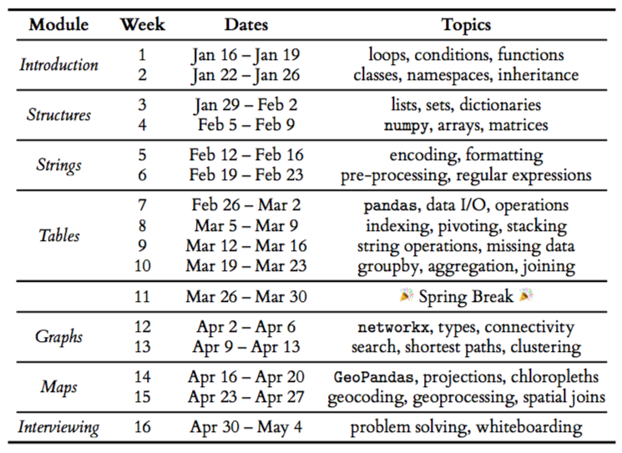
Where we are

Slide 4
Week overview
Lab Assignment 07 for Tables III & IV module due by 11:59pm on Monday, April 9
Lab sections this afternoon: Revisit Lab Assignment 07 questions
Reading
network tutorial and Borgatti, et al. (2009) “Network Analysis in the Social Sciences”
Lectures
Monday – Grades, fundamentals of network analysis
Wednesday – Analyzing network data
Friday – Debug challenge + weekly quiz

Slide 5
Grades
Grades for quizzes and lab assignments are up on Canvas
Bottom 3 Friday Quizzes dropped
Weights
45% weight on Lab Assignments
40% on Weekly Quizzes
15% participation → Lecture, Lab, Office Hours, etc.
Remaining assignments
5 Weekly Quizzes
4 Lab Assignments (Tables III & IV: 07; Graphs: 08; Maps: 09; Interviewing: 10)

Slide 6
Honor Code
“On my honor, I have neither given nor received unauthorized assistance”
Authorized assistance: citing author/URL, listing collaborators, etc. in a comment/markdown
Recall Problem 0 in Assignment 02 as well as listing names of collaborators from debug challenge form
Multiple instances of code re-use without attribution
Using advanced methods we haven’t discussed in class
Identical code blocks, renaming variables in identical code, minor refactoring of code
Syllabus: “Students should be prepared to explain their implementation in a code review”
Don’t submit code unless you’re prepared to explain it or re-implement it in a 1-on-1 meeting /w me
Three strikes policy → alternative is reporting directly to OSCCR for them to adjudicate
First strike: assignment grade halved
Second strike: assignment grade zeroed
Third strike: class grade is F, all three cases reported to OSCCR
Notes:
Office of Student Conduct and Conflict Resolution

Slide 7
Fundamentals – Dyads
Social behavior does not occur in isolation, we live in web of interactions, relationships, affiliations, flows, and similarities
The dyad is the fundamental unit of analysis
A dyad contains two nodes (also vertex) and an edge (also link) connecting them
Nodes: {A, B}
Edge: {(A,B)}
It’s often easier to represent these relationships visually
Nodes are shapes (circles here)
Edges are lines (arrows here)
A
B

Slide 8
Fundamentals – What is a relationship?
Actors (nodes, vertices)
People, groups, organizations, communities, nation-states
Relations (links, ties, edges)
Evaluations of one person by another (friendship, liking, ...)
Transfers of material resources (lending, donations, ...)
Association or affiliation (membership, attendance, …)
Behavioral interaction (communication, intercourse, …)
Movement between places or statuses (migration, commuting, …)
Physical connections (roads, routers, …)
Formal relations (authority, supply chain, …)
Biological relations (kinship, descent, …)

Slide 9
Fundamentals – Networks as collection of dyads
A network (also graph) is a set of nodes and the links connecting them
Social network analysis (now network science) provides a set of theories and methods for understanding the structure and dynamics of relationships
A dyad contains two nodes (also vertex) and an link (also edge) connecting them
Nodelist: {A, B, C, D}
Edgelist: {(A,B), (B,C), (A,C), (A,D)}
Not all possible edges are present in this network → most networks are sparse
Missing edges: {(B,D), (C,D)}
A
D
B
C

Slide 10
Fundamentals – Directed networks
A
Edges can be undirected or directed
Undirected: direction doesn’t matter → edge (A,B) is identical to edge (B,A)
Directed: direction matters → edge (A,B) is different from edge (B,A)
Edge notation is (starting node, ending node)
Directed edges typically visualized with arrows, undirected without arrows
Edgelists for graphs at right
Top (undirected): {(A,B), (B,C), (A,C), (A,D)} → 4 edges
Bottom (directed): {(A,C), (A,D), (B,A), (B,C), (D,A)} → 5 edges
D
B
C
A
D
B
C

Slide 11
Fundamentals – Weighted networks
A
Edges can also be weighted
Stronger relationships, more interactions, greater similarity, longer tenure, etc.
Weighted edge notation is (starting node, ending node, weight)
Weighted edges typically visualized with thicker/thinner edges
Edgelists for graphs at right
Top (undirected): {(A,B,6), (B,C,9), (A,C,12), (A,D,3)}
Bottom (directed): {(A,C,15), (A,D,12), (B,A,1), (B,C,12), (D,A,3)}
D
B
C
A
D
B
C

Slide 12
Network vocabulary
A
B
C
Isolate
Nodes
Triad
Network
Relations
D
E
Component
Dyad
Pendant
F
G

Slide 13
Fundamentals – Sociomatrix
A
A
D
B
D
B
C
C
 | A | B | C | D
A | - | 1 | 1 | 1
B | 1 | - | 1 | 0
C | 1 | 1 | - | 0
D | 1 | 0 | 0 | -
 | A | B | C | D
A | - | 0 | 1 | 0
B | 1 | - | 1 | 0
C | 0 | 0 | - | 0
D | 1 | 0 | 0 | -
Nodes don’t connect to themselves
Matrix is symmetric
Matrix is not symmetric
C has no out-going links to A,B,D

Slide 14
Fundamentals – Attributes
Nodes can have attributes
Categorical: Gender, race, occupation, membership, etc.
Typically visualized with different colors
Continuous: Age, wealth, centrality, etc.
Typically visualized with different sizes
Edges can also have attributes (in addition to weight)
Timestamps common for representing changes in network over time
Multigraphs describe multiple kinds of relationships connecting nodes
Exchange, Trust, Communication relations among same set of actors
A
D
B
C

Slide 15
Centrality
Which actor is the most important in this network?
C
A
F
D
H
I
J
B
G
E

Slide 16
Centrality – Degree
Degree: total number of links with other actors
In-degree: Directional links to actor from other actors
Out-degree: Directional links from actor to other actors
“Popularity”
C
A
F
D
H
I
J
B
G
E

Slide 17
Centrality – Closeness
How easily one actor can reach rest of network
Actor with shortest average path length
“Pulse-taker”
C
A
F
D
H
I
J
B
G
E

Slide 18
Centrality – Betweenness
How much an actor lies between distinct groups
Number of geodesics passing through actor
“Broker”
C
A
F
D
H
I
J
B
G
E

Slide 19
Centrality – Eigenvector
Centrality is a function of neighbor’s centrality
Nodes are central if their neighbors are well-connected
“Influencer”
C
A
F
D
H
I
J
B
G
E

Slide 20
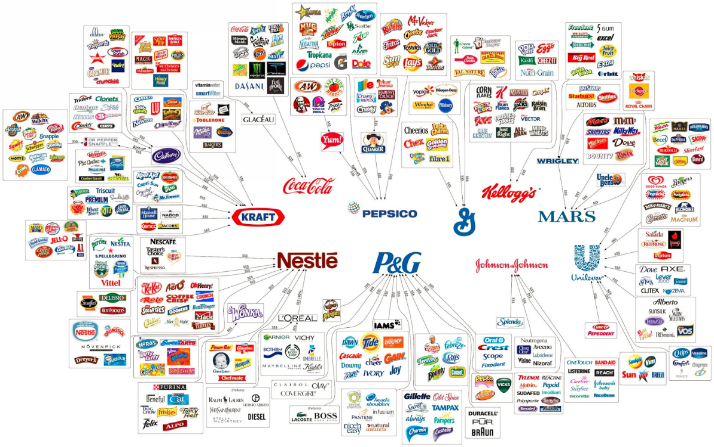
Examples of networks
https://www.oxfamamerica.org/explore/stories/these-10-companies-make-a-lot-of-the-food-we-buy-heres-how-we-made-them-better/

Slide 21
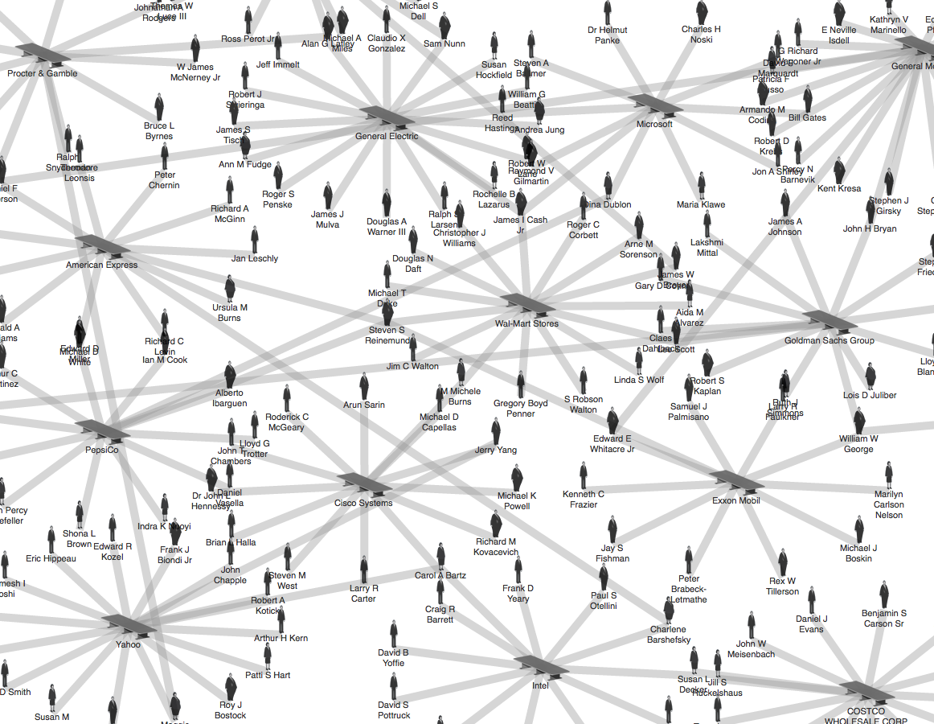
Examples of networks
theyrule.net

Slide 22
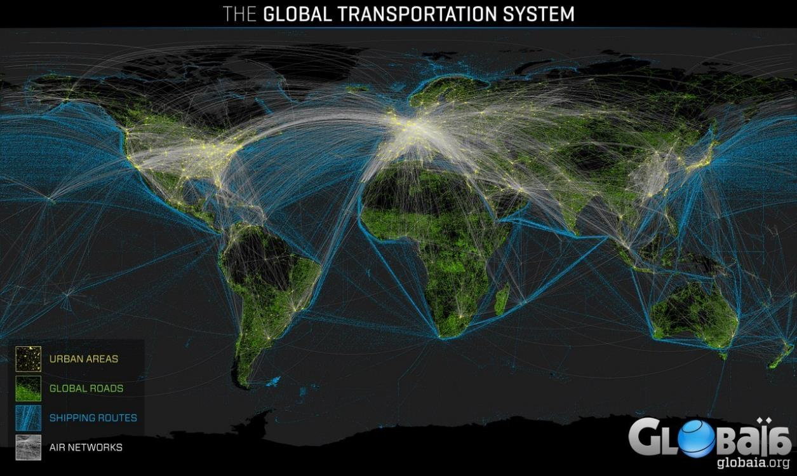
Examples of networks

Slide 23
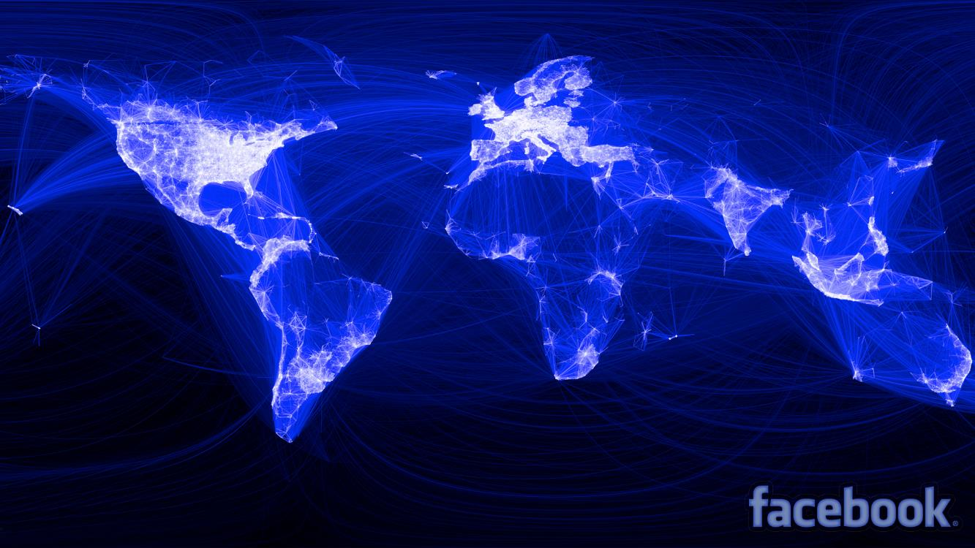
Examples of networks

Slide 24
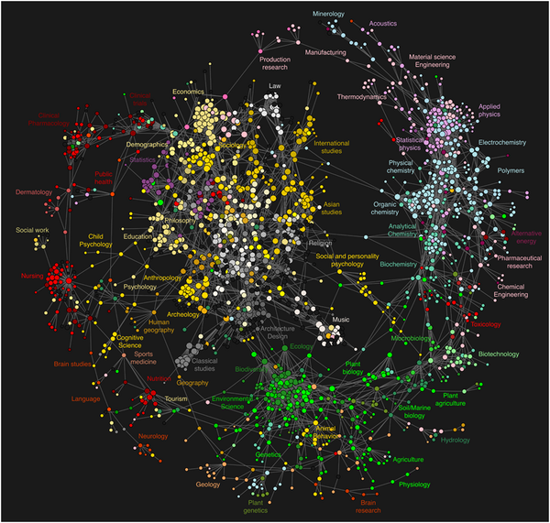
Examples of networks
http://journals.plos.org/plosone/article?id=10.1371/journal.pone.0004803

Slide 25
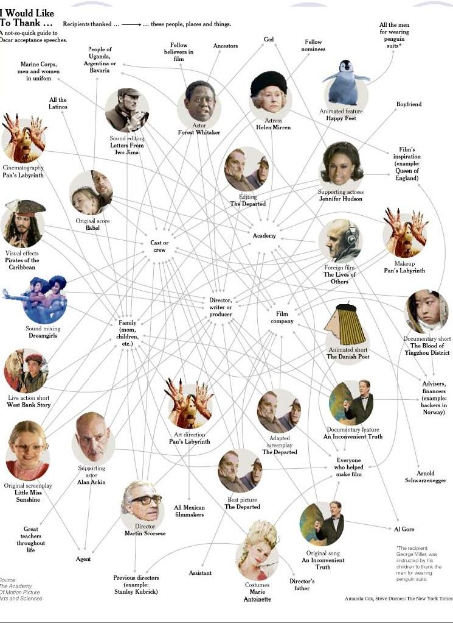
Examples of networks

Slide 26
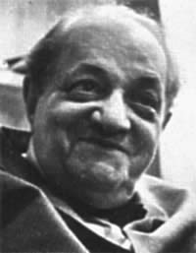
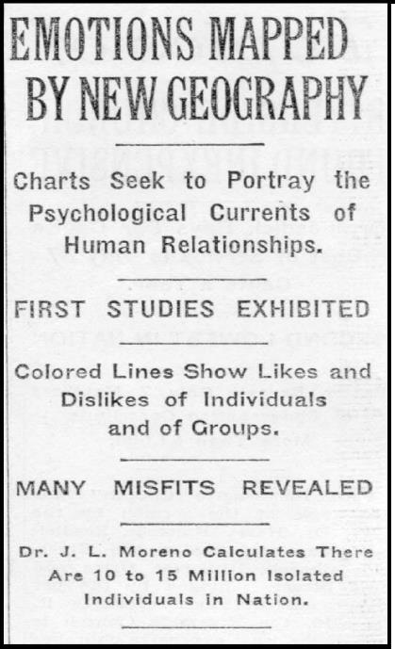
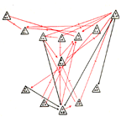
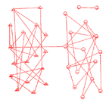
1930s: Jacob Moreno
Jacob Moreno introduced the ideas and tools of sociometry
Sociograms combine network data and data visualization
Trained as a psychiatrist, notorious womanizer, not a methodologist (more later)
Megalomaniacal tendencies, abandoned sociometry to focus on group therapy but returned with a second edition in 1950s to claim credit for developments
Still credited as “father” of social network analysis…
Friendship choices among 4th graders (Moreno 1934)
Positive & negative affect in a football team (Moreno 1934)

Slide 27
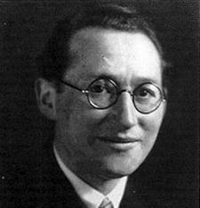
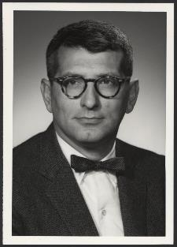
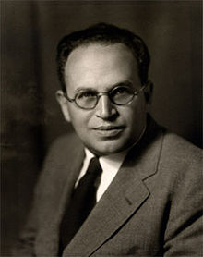
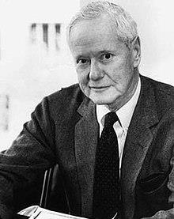
1950s: Group networks
Kurt Lewin (top), “father” of social psychology, in 1930s is interested in how individual behavior influenced by others’ behaviors, “group dynamics”
Alex Bavelas (2nd), a Lewin student, pioneered ideas to use experiments to analyze how social structure influences group performance
Paul Lazarsfeld & Robert Merton (3rd), sociologists who had been exposed to Moreno & Jennings, became interested in mass communication and influence
Everett Rogers (bottom), a rural sociologist interested in spread of agricultural inventions, discovers sociometry as a way to explain “diffusion of innovation”

Slide 28
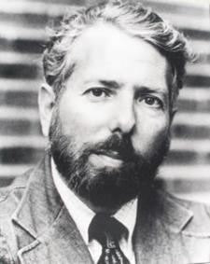
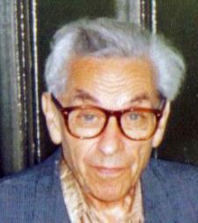
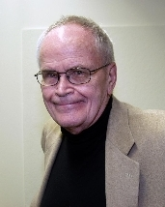

1960s: Methodological acceleration
Stanley Milgram (top), the (in)famous social psychologist, introduces the “small world experiment” popularized by the “six degrees of separation”
Paul Erdos (2nd), the famous mathematician, does develops models of “random graphs” in 1959 that become the foundation of statistical inference on networks
Harrison White (3rd), a theoretical physicist, worked at Bavelas’ lab in 1950s, and starts a second dissertation in sociology, moves to Harvard in 1963 and starts the “Harvard Revolution” in sociology, advises many influential researchers
Granovetter (bottom), a White student, publishes “The Strength of Weak Ties” rejected in ’69, accepted in ‘73, now has >45,000 citations making it the most cited paper in sociology; also known for work on embeddedness

Slide 29
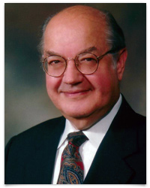
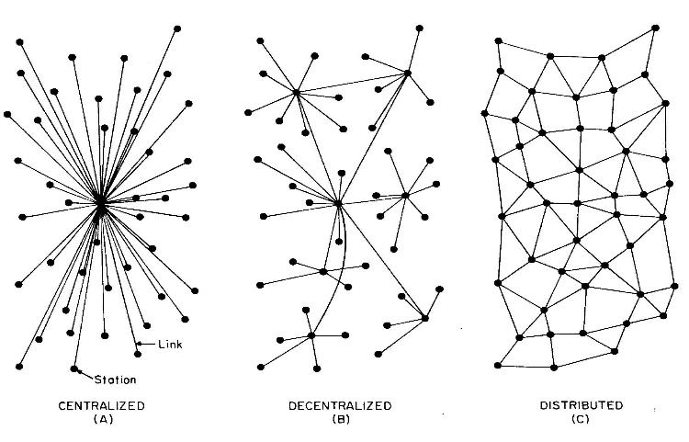
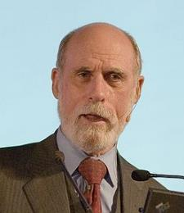
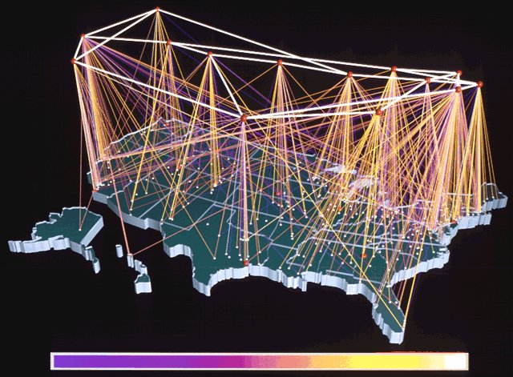
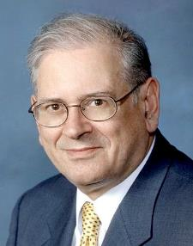
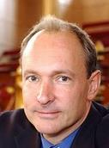
70s-80s: Internet
Defense Advanced Research Projects Agency (DARPA) funds research to support “interconnecting” big, expensive mainframes
Paul Baran (top) hired to build computer networks that would remain reliable even if central nodes were destroyed (in a nuclear war)
Vincent Cerf and Robert Kahn (middle) invent protocols like TCP/IP for routing information in a distributed network assuming unreliable nodes
Tim Berners Lee (bottom) builds on TCP/IP and develops HTML, URLs, web browsers, web servers
Donna Cox & Robert Patterson, 1992
Notes:
Paul Baran top
Tim Berners Lee, Vincent Cerf, Robert Kahn

Slide 30
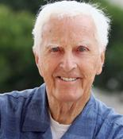
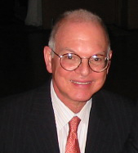

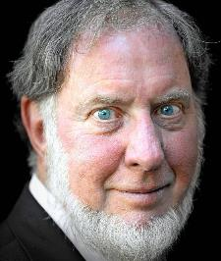
80s-90s: Social capital
Linton Freeman (top) integrates mathematical graph theory and sociological role theory to propose new definitions of centrality, including betweenness centrality
Barry Wellman (2nd) organizes SNA community, studies role of networks in offline communities and in mid 1990s becomes interested in potential of “online communities”
Ron Burt (3rd) uses Freeman’s betweenness centrality to argue that brokers between disconnected groups have more power than people with many connections
Robert Putnam (bottom) publishes Bowling Alone in 1995 arguing the degradation in American social and political life is a lack of meaningful social relations (“social capital”)
Notes:
Sunday New York Times Magazine, Style & Entertaining Section, Fall 2003
“At a party for her new line of Le Sportsac bags, Gwen Stefani and the host, Timothy Schifter, play classic sociometric roles as the other guests jockey for degree centrality”
William Middleton Popular Mechanics ….. wouldn’t Moreno have been pleased???

Slide 31

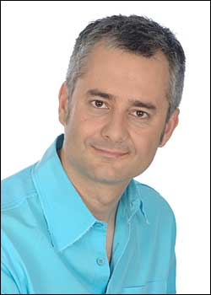
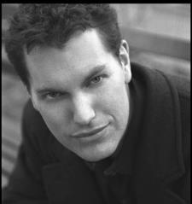
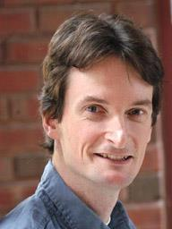
90s-00s: Network science
Jon Kleinberg (top), a theoretical computer scientist, begins to analyze the structure of hyperlinks on WWW and develops HITS algorithm, which influences Google’s PageRank
Lazlo Barabasi (2nd), a statistical physicist, develops the “preferential attachment” model to explain the extremely skewed connection patterns in vastly different datasets
Duncan Watts (3rd), a applied physicist, develops a “small world model” with advisor Strogatz that explains how a few long-distance ties can create Milgram’s small worlds
Mark Newman (bottom), a statistical physicist, develops efficient statistical methods for finding community structure, assortative degree mixing, and modeling connectivity

Slide 32





00s-10s: Computational social science
Joe Konstan & John Riedl (top) developed “recommender systems” from user-movie networks that now power algorithms behind Netflix, Amazon, Facebook, etc.
Alex Vespignani (2nd) developed models of dynamic networks with applications for predicting and controlling epidemic processes (diseases, memes, etc.)
David Lazer (3rd) proposed in 2009 that large digital data can enable new forms of social science not reliant on surveys, ethnography, interviews, simulations, lab experiments
Matt Salganik (bottom), a Watts student, did first large-scale online social experiments showing how popularity dynamics can be biased and manipulated

Slide 33
History of Network Science is note white & male
Beth Wellman (1926), Helen Bott (1928), Elizabeth Hagman (1933) pioneered network data collection by examining relationships among children. They combined interview and observational data, developed matrix notation for relationships, and measured biases in self-reported data
Helen Hall Jennings (1934), a psychology PhD student at Columbia specializing in statistics, almost certainly drove most of the methods and data collection of Moreno’s “sociograms” but was only partially credited by Moreno until 1980s → mother and founder of SNA
Allison and Elizabeth Davis and St. Clair Drake analyzed relational data in their African American communities in the 1940s, their Southern Women network dataset is a classic on stratification
Elizabeth Bott analyzed how family roles structured urban families’ social networks in 1950s
Kathleen Carley, Bonnie Erickson, and Karen Cook emerged in 1980s applying networks to study textual data, deviance, and exchange/trust (respectively)
Reka Albert, Michelle Girvan, Lada Adamic, Ginestra Bianconi, Jennifer Neville, Leman Akoglu, Kristina Lerman, Karrie Karahalios, Marta Gonzalez, Sandra Gonzalez-Bailon, Meeyoung Cha received PhDs in 90s-00s and are examples of influential senior network science researchers

Slide 34
Class Notebook
Download and open “Class 30 Notebook”

Slide 35
What’s Next
Class 31 on Wednesday
Relational data formats and data analysis in networkx
Class 32 on Friday:
Exercises and weekly quiz
Week 13: Graphs II
Week 12: Graphs/Networks
Lab Assignment 08 assigned Friday, April 6 and due Monday, April 16

